Slide 1


College & University Election
system
Developed By: Raghaw Kumar
Course: B.Tech. CSE
Scholar NO.:1501-21-001
Enrollment No.:LNCBBTCSE119

Slide 2
Introduction
It is a console based College /university Election system.
From this we can conduct election and chose candidate
We also can conduct new election year wise.
The system is completely believable
It is made by C-Programming language
It is easy to use.

Slide 3
Start
Fig: Flow chart
Menu
If choice is 1
False
If choice is 2
False
True
True
Student panel
Admin panel
If choice is 3
True
False
If input 0
User id correct can vote
True
Conduct new vote calculate result
Logout
End

Slide 4

SYSTEM REQUIREMENT
Hardware Required:
Operating System: Windows 98, 2000, XP , Vista, 7, 8, 8.1, 10, 11
Memory: 512 Mb RAM
Storage: 60 free space
Header file used:
#include<stdio.h>
#include<conio.h>
#include<string.h>
#include<stdlib.h>
Software Required:
GCC Version 9.2.0
Command Prompt
Visual Studio Code
Technique Used:
C-Programming language
File Handling

Slide 5
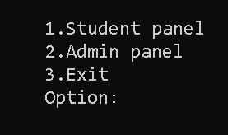
Output1

Slide 6
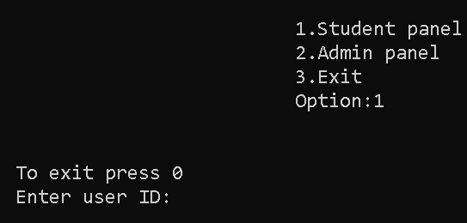
Output2
1.

Slide 7
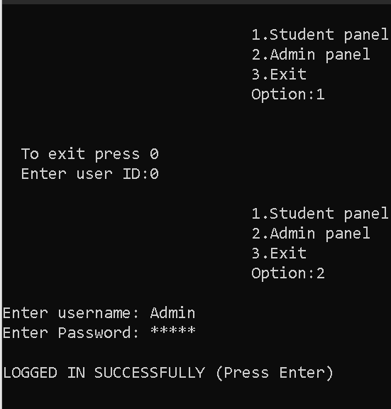
Output3

Slide 8
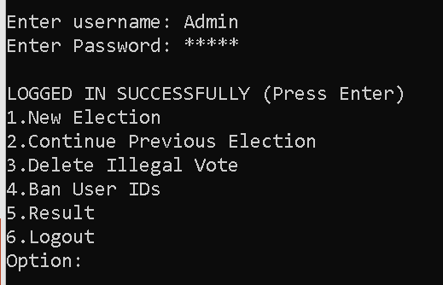
Output4

Slide 9
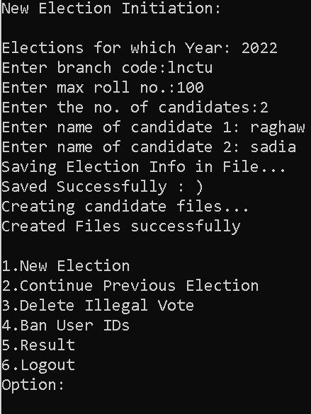
Output5

Slide 10
Conclusion
In past, when technology is not evolved it is difficult to Conduct election by this program we can easily save and read phonebook
This is console base Election conducting program made in C-programming language
Data is stored in hard disk permanently by using file handling

Slide 11


